Slide 1
3/5 Class 8 – Risk Management
Things to be careful about with a wrapper
Regularization
Fitness landscape
ML models: Neural nets
Risk management in business

Slide 2
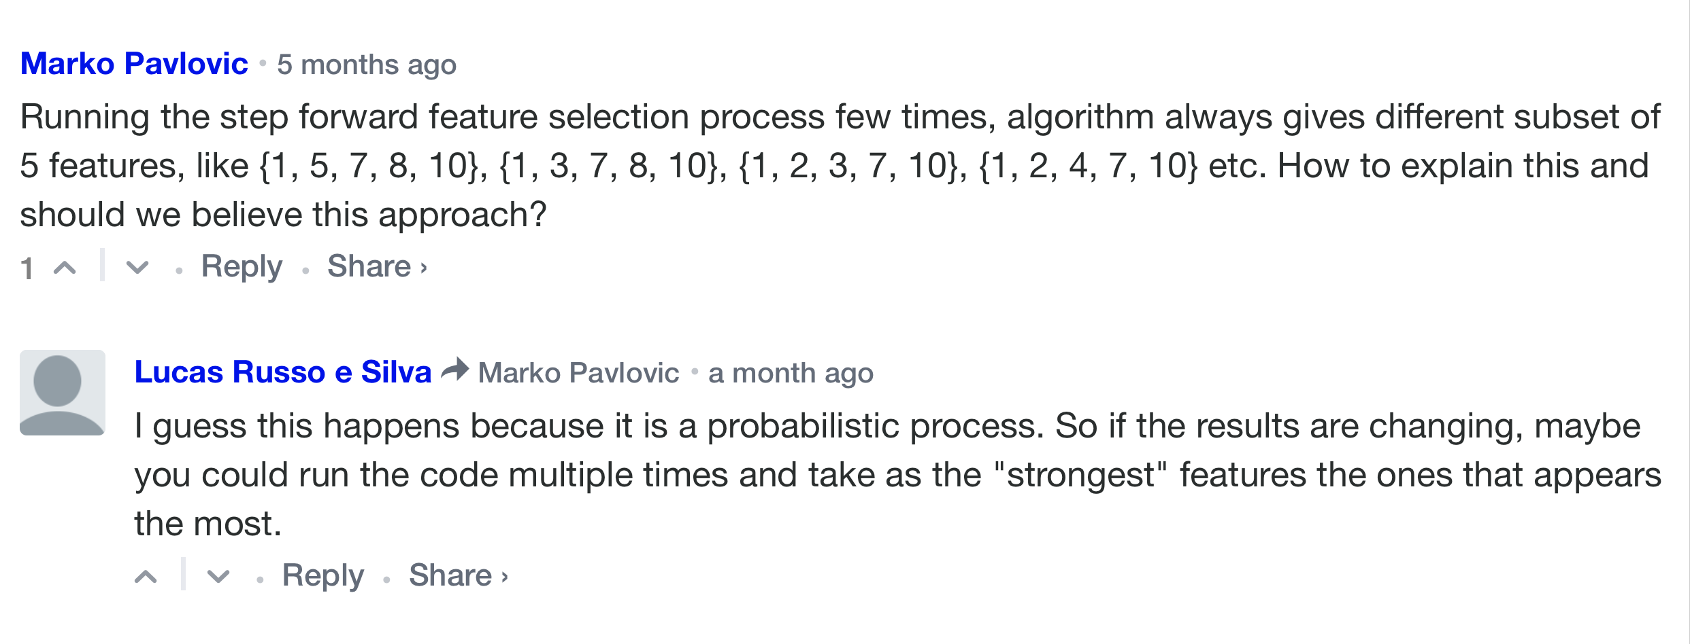
Stepwise Selection Can Give Different Results
Particularly with small data sets, stepwise selection can give quite different results with different runs on the same data. Why? What should you do?
2 and 5 are both important but strongly correlated. Only need one of them.

Slide 3
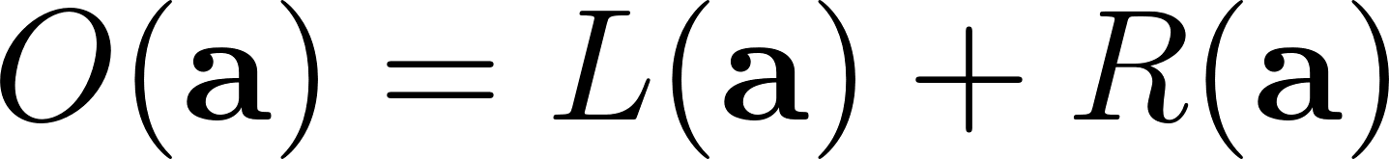
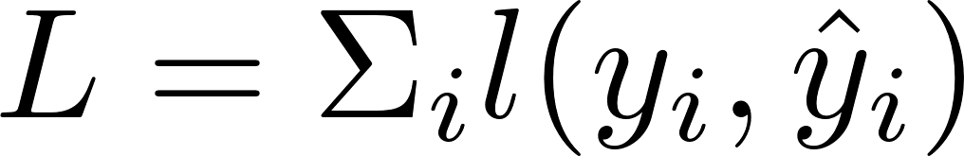
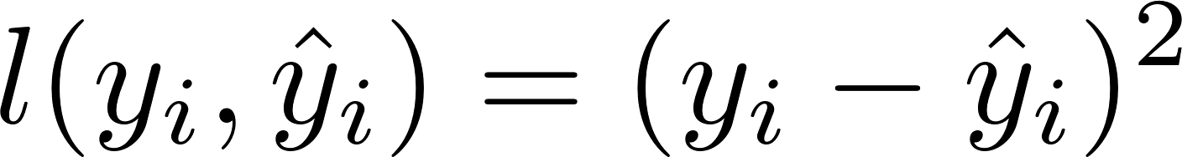
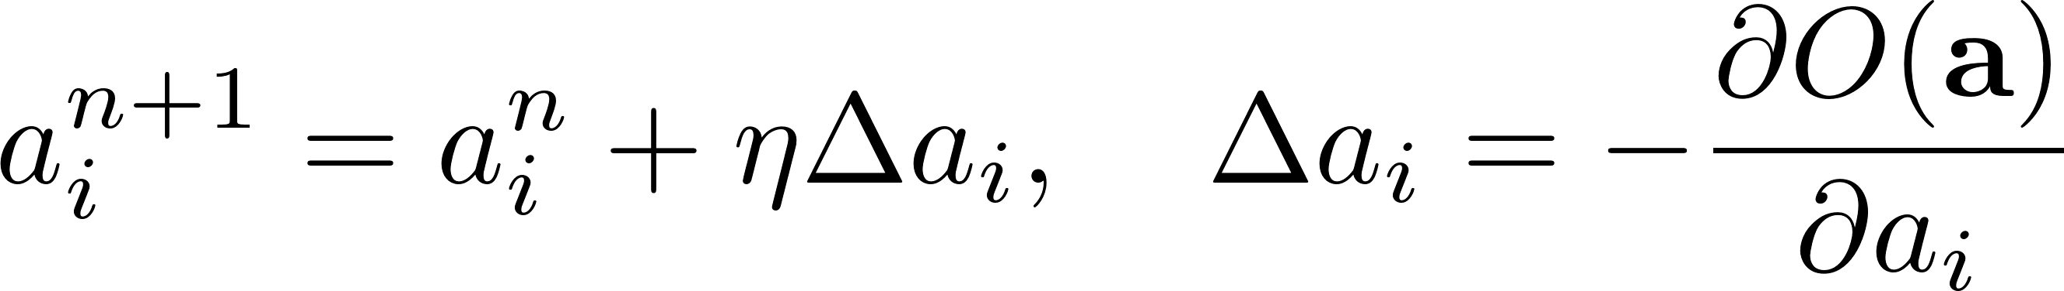
Each ML Method Has An Objective Function and Learning Rules
Objective function is typically a Loss term (error) plus Regularization:
adjustable parameters
Loss/error term can be
MSE:
Logistic error:
Error
Regularization
The regularization term minimizes model complexity by minimizing the parameters a
Can use a variety of regularization forms, e.g.
L1 norm (Lasso):
L2 norm (Ridge):
Regularization strength
Each modeling method also has a set of training rules to adjust the parameters a:
Learning rate

Slide 4
Ridge Regression (Tikhonov Regularization)
Ти́хонов
Remember linear regression:
y
x₁
. . .
x_{n}
a₁
In matrix form:
Y
=
X
A
. . .
. . .
. . .
. . .
y
x₁
. . .
x_{n}
a_{n}
Minimize the mean square error (MSE) gives
Typically close to singular
Because is close to singular we add a “ridge” to it:
. . .
This is the same as adding a term to the MSE for the minimization:
Minimize
where
is called the L₂ norm
Try to make the MSE small along with the number/sizes of the coefficients a_{i}

Slide 5
Regularization for Feature Selection
Ridge regression: Minimize
where
is the L₂ norm
Lasso regression: Minimize
where
is the L₁ norm
Elastic Net regression: Minimize
All these methods minimize the MSE along with the number/sizes of the coefficients a_{i}.
Regularization is an embedded feature selection method.

Slide 6
Do a 1-d Linear Regression on the Board

Slide 7
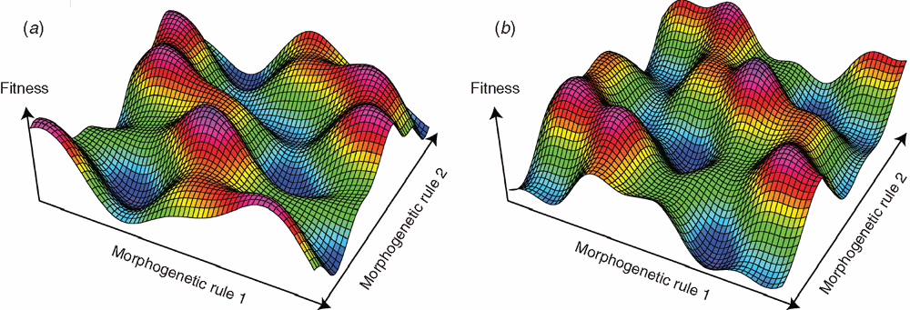
Fitness Landscape and Local Minima
The fitness landscape is the surface of the objective function (fitness) plotted over the space of model fitting parameters
For linear regression the fitness landscape is a quadratic:
For nonlinear models the fitness landscape can be very complex:
Fitness (SSE)
$$\frac{∂SSE}{∂B}=0$$
finds the minimum
quadratic in B
Parameters B
We move iteratively toward a local minimum:
Objective
(error + complexity)
Learning rate
Can start with a high learning rate, then decrease it to hope to escape local minima
Parameter 2
Parameter 1

Slide 8
Ways to Improve Model
Weighting
Fraud problems are highly imbalanced. Models generally do better learning from balanced data sets.
Good/bad balances somewhere between 1:1 to 10:1 are typically best.
Can
Subsample the goods.
Upsample the bads: use weights, reproduce the records, “invent” new artificial bads (ROSE, SMOTE)
Capping variables
Many variables have long tails, where high is bad.
The model has to learn this entire range, but frequently only “slightly high” is necessary to learn.
Model can do better by focusing on the area where it matters, similar to plotting a long tail distribution with a fixed number of bin.
Solution – capping (max) some variables can make the model perform better.

Slide 9
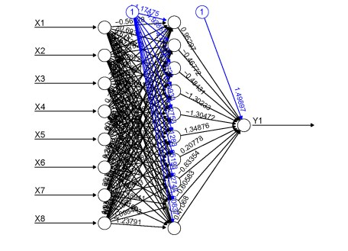
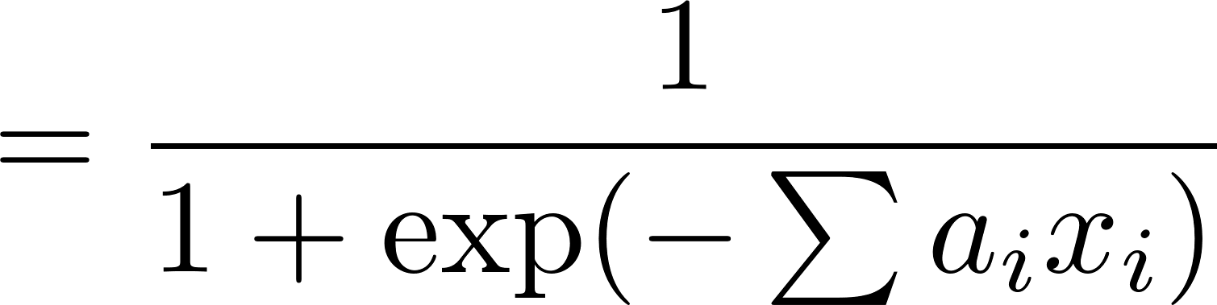
Neural Net or Multi Layer Perceptron (MLP)
A typical neural net consists of an input layer, some number of hidden layers and an output layer.
All the independent variables (x’s) form the input layer.
The dependent variable y is the output layer.
The hidden layer is a set of nodes or “neurons”
Each node in the hidden layer receives weighted signals from all the nodes in the previous layer and does a transform on this linear combination of signals.
The transform/activation function can be a logistic function (sigmoid), or something else.
Input layer
Hidden layer
Output layer
Sigmoid activation function
Parameters: # hidden layers, # nodes/layer, transform/activation function

Slide 10
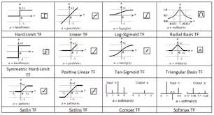
Unravel the Mysteries of a Neural Net:
vector
scalar
scalar
Input
Output
vector
Weight matrix
Weight vector
scalar
vector
Input vector
Parameters/weights adjusted during training
Transfer functions
A neural net is a mathematical function that maps inputs to an output with a bunch of adjustable parameters. It uses vector and matrix multiplication with transfer functions.

Slide 11
How is a Neural Net Trained?
The weights are trained by backpropagating the error, record by record.
Data is shown to the neural net, record by record, and the weights are slightly adjusted for each record.
The entire data set is passed through many times, each complete pass is called a training epoch.
For each training record, we calculate the error. Typical error/loss function is the square of the errors,
At each layer, starting from the end, one propagates the error backwards to each node, and we calculate the gradient of the error with respect to the node weights.
The weights are slightly adjusted for each data record, and the records are passed through many times as the weights settle into a local optimum
Learning rate

Slide 12
Do a Neural Net on the Board

Slide 13
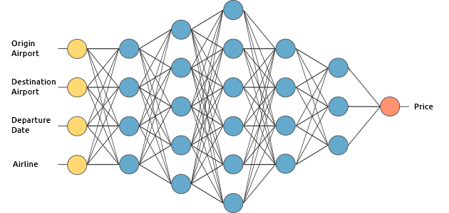
Deep Learning
Deep Learning is a neural net architecture with more than one hidden layer (hence “deep”). It’s not really new but wasn’t very practical until hardware and algorithms improved sufficiently, particularly with GPUs.
x₁
x₂
Input
Output
x₃
x₄
A neural net with more than one hidden layer is a deep learning neural net.
The hidden layers can have any number of nodes

Slide 14
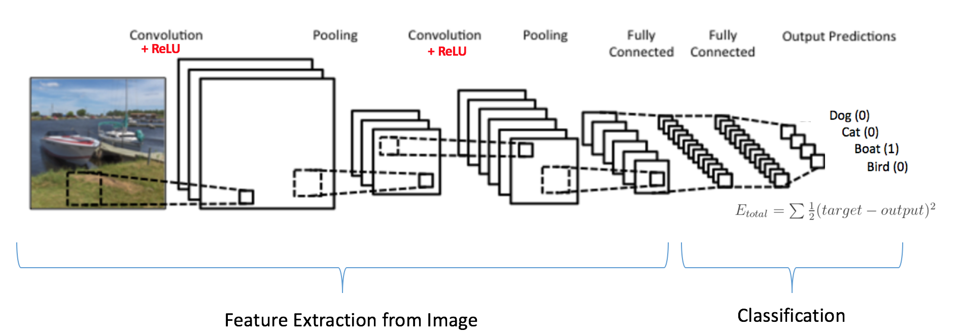
Convolutional Neural Net (CNN)
Specific kind of deep learning, designed for modeling on images.
Use a sliding patch at various resolutions to automatically discover basic building block features like edges, curves…
The basic features are combined into more complex features in further layers.
The final image is learned as a combination of the complex, automatically-discovered features.
Deconstruct image into overlapping patches at different resolutions
Maxpooling layers find basic shapes, combine into features that form a “basis” for the image
Train a fully connected nn to combine the features into the image
Early layers are loosely connected
Later layers are fully connected

Slide 15
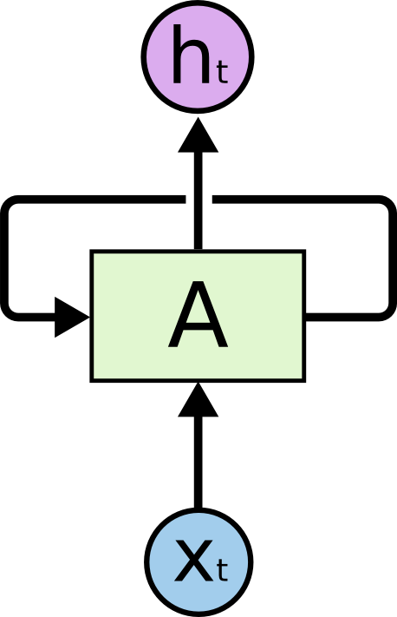
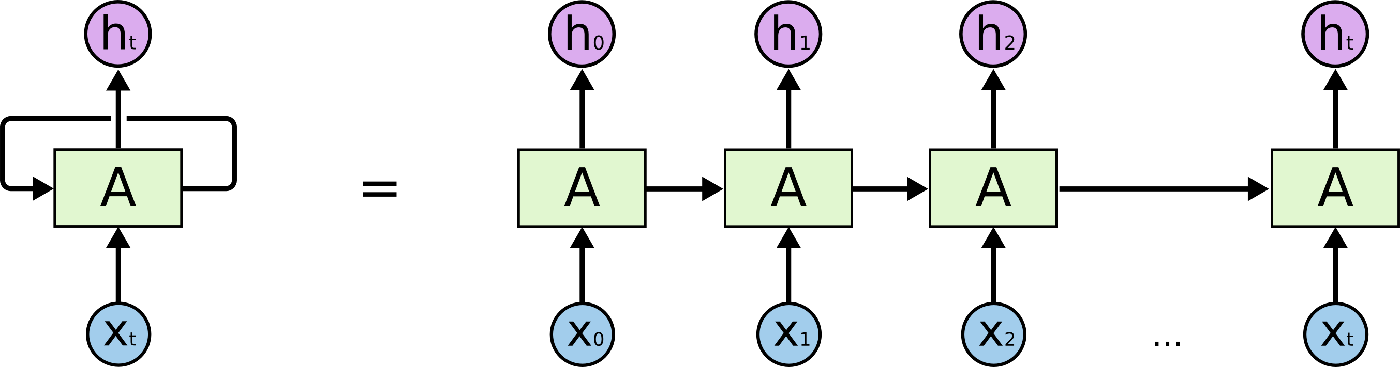
Recurrent Neural Net (RNN)
Designed to remember past information
output
A recurrent neural net has a feedback loop where the hidden layer output comes back in as part of the input
Here’s a regular neural net:
input
Final output of the nn
One can “unfold” this feedback loop, and it behaves like a sequence of regular NNs.
This is a natural architecture to process a series of evolving input vectors.
Understanding LSTM Network, Colah’s blog

Slide 16
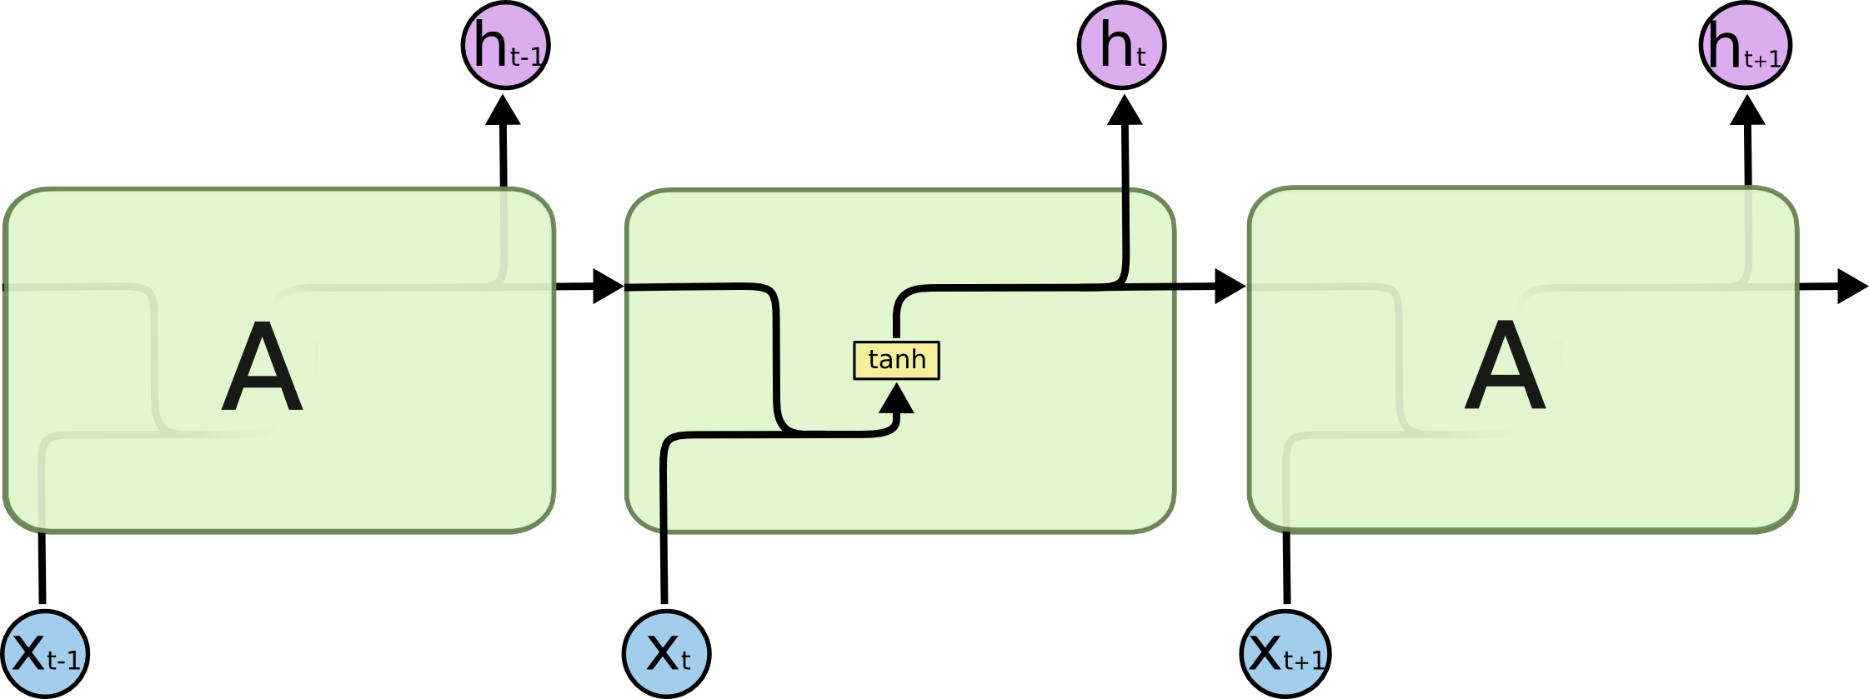

Long Short Term Memory Net (LSTM)
Designed to remember past information over a long time horizon
Here’s a regular recurrent neural net:
How much of the old info to remember or forget [0,1]
Ongoing memory state on a “conveyor belt” running through
Add in new info if it helps
Add some of the ongoing memory to the neural net output
An LSTM neural net has a special internal structure
Regular RNN output to the next iteration
Understanding LSTM Network, Colah’s blog

Slide 17
Break

Slide 18
Risk Management in Business
Risk management is the process of identifying, assessing and controlling threats to an organization. These threats, or risks, could stem from a wide variety of sources, including financial uncertainty, legal liabilities, strategic management errors, accidents and natural disasters.
Classic risk management areas include fraud, credit risk, portfolio losses, legal risk, reputational risk
Many companies have a Chief Risk Officer who oversees all corporate risk areas, primarily financial risk (credit and fraud).
A company will typically stress test their business. Consider what would happen under a variety of bad scenarios (bad economy, natural disaster…)
There are many decision tools including scores and forecasts for fraud, credit losses, bankruptcies, collections, all on both individual and portfolio levels.
Decisions made: account openings/closings, credit line increases, over-the-limit authorization, input to interest rates, cash advances, general transaction approval, portfolio loss exposure, funds financing, loss reserves, expand portfolios, contract or expand exposure…
Generally there is a healthy conflict between risk management and marketing

Slide 19
Business Models Must Be Compliant
U.S. credit models regulated under FCRA (1970) and ECOA (1974)
Fraud models regulated under GLBA (1999)
Can’t use protected class information to deny credit. Protected classes include race, gender, religion, age, marital status, disability
Disparate Treatment – can’t use any variable built from information about a protected class
Disparate Impact - even if no protected class variables are used, the model still can’t have differentiated treatment on a protected class
Modelers know not to explicitly use any field about a protected class
Modelers work with business lead, client, lawyers, regulators to maximize model performance and minimize disparate impact
What do we do?

Slide 20
Modify Models to Minimize Disparate Impact
Good
must lower DI
Baseline Model
Model Goodness
KS, FDR
Remove variables
and retrain
Want high model goodness,
low disparate impact
Remove offending variables
Poor
Low
Amount of Disparate Impact
High
Avoid all protected class info when building variables
Use BISG* to infer racial disparate impact caused by each model variable
Remove offending variables and retrain the model
*BISG – Bayesian Improved Surname Geocoding – use census data with last names to infer race on each record

Slide 21
Help With Project 2/ Talk About Exam

